Slide 1
Age Detection
By: Bhumika Srinivas & Michelle Quach

Slide 2
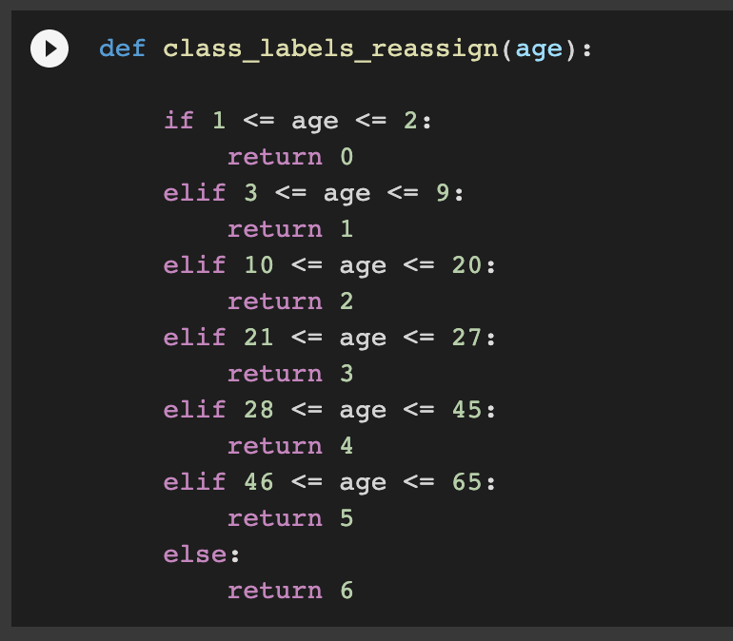
Problem Statement
Age detection brackets for static images using CNNs.
Age and gender analysis are crucial for authentication, human-computer interaction, behavior analysis, product recommendation based on user preferences, and many other applications.
Notes:
The problem we are tackling in the project is the age detection of static images using a deep learning method - CNNs. And by age detection we mean predicting a possible age range for an image. And these age ranges were determined by us using classification and creating 7 target brackets. The ages for the images were extracted from the file and folder names.
Coming to why creating such a model is useful? It can be most popularly useful for product recommendation and authentication. Companies for example can understand what products and services different customer groups want and can afford.

Slide 3
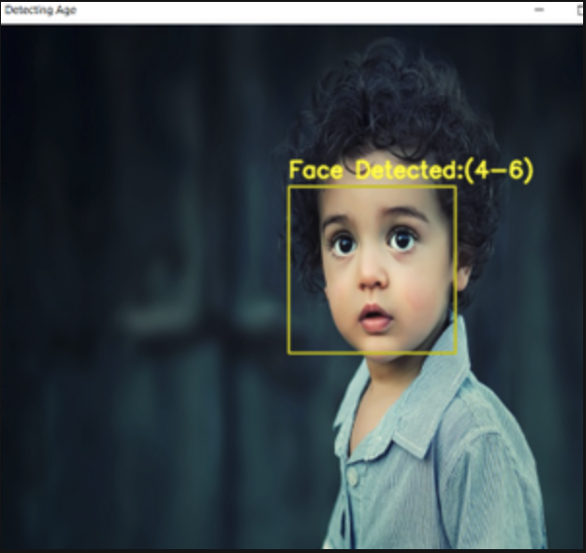
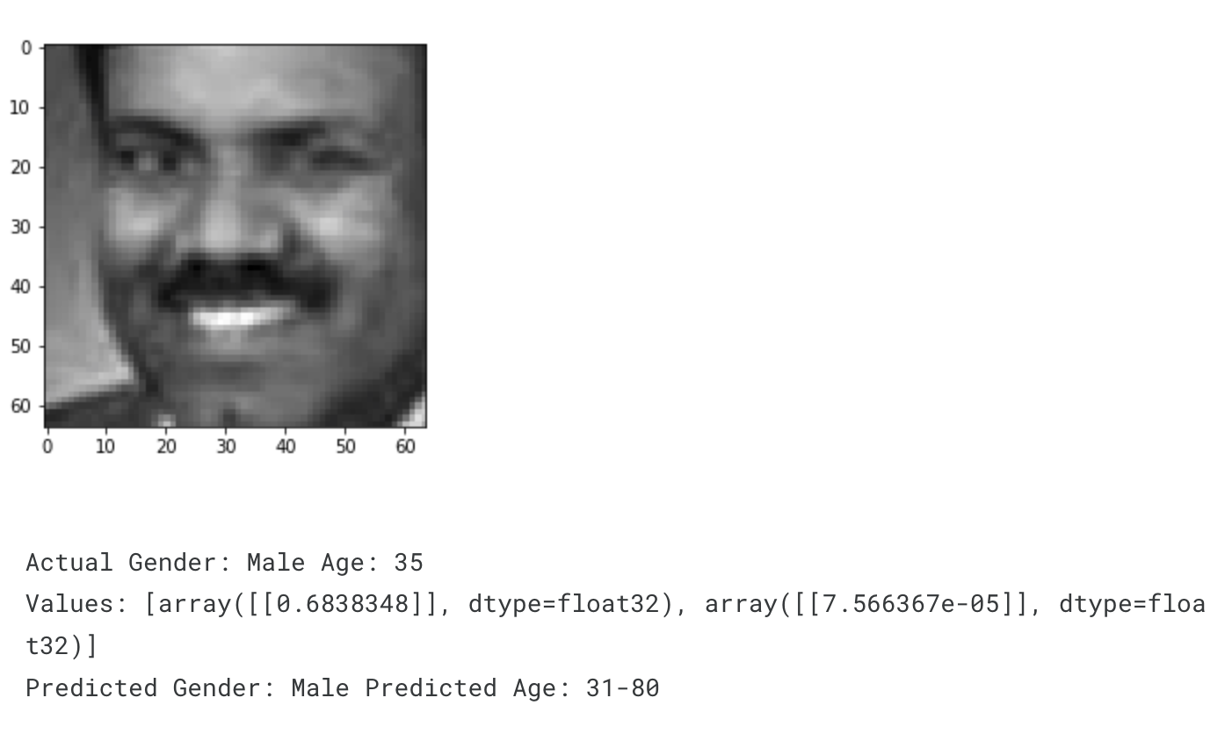
Other Work
Several others have attempted to predict age (within bucket range)
Used CNN, OpenCV, etc.
Kaggle, Geeks for Geeks, Medium.com, etc.
Notes:
We originally thought of this project as something that would be fun to explore not knowing how popular it really was as a machine learning project. There are hundreds of resources online for predicting age with machine learning. Just a few examples that we saw were from Kaggle, Geeks for Geeks, Medium.com and more. Every one of these projects had a different way of looking at this issue (i.e. the model they were using, the algorithm they were using, the data they were using, etc).

Slide 4
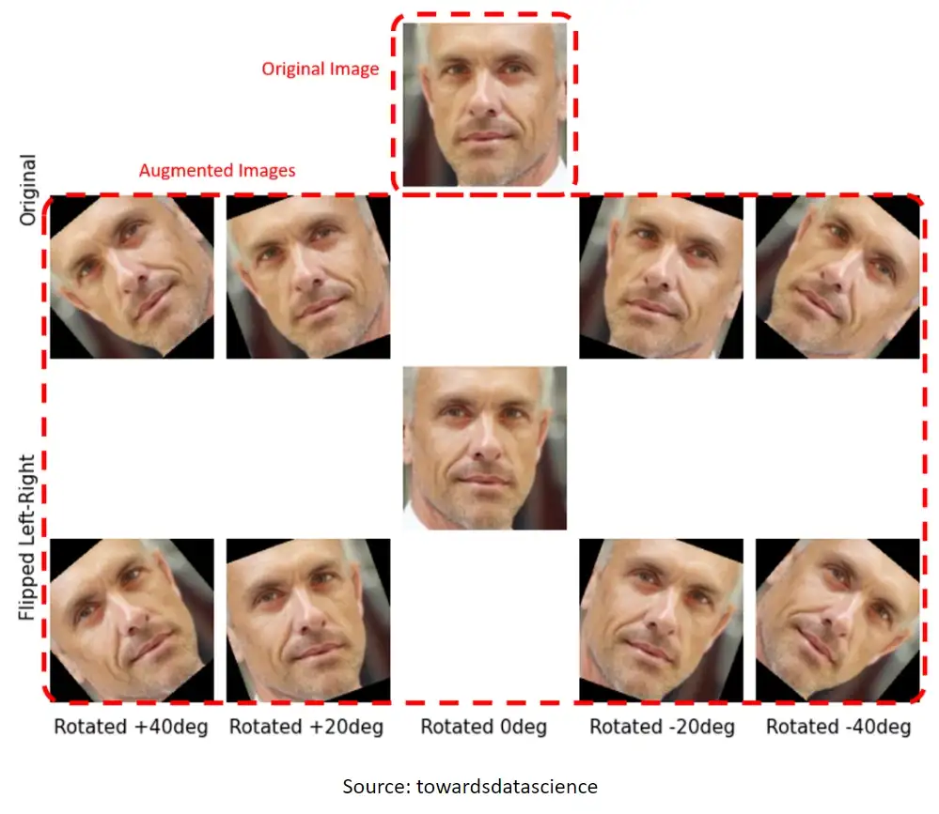
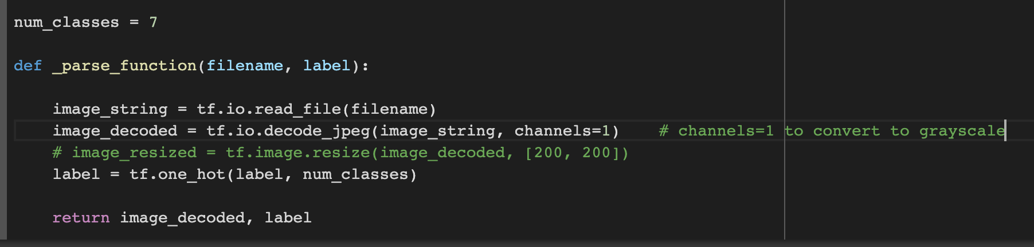
Data
Phase 1:
Collected data from a Kaggle source containing around 9000 images
Accuracy on the test data was capping at 53%
Phase 2: Collected augmented train data and test data from a medium source
Training data was augmented - rotation and mirroring
Grayscaled the images to mostly reduce the effect of lighting in the color RGB images
Notes:
Finding the right set quality and quantity of images was a little challenging. We initially sourced data from Kaggle and it contained around 9000 images. We did a 70-30 train test split. The accuracy of the CNN model was capping at 53% though we incorporated techniques like changing the CNN model and decreasing the learning rate. We came to learn that either our dataset was really small or the quality of the images were not that great.
So, we decided to use data from the source we were referencing for the CNN architecture. Training data consisted of 200,000 augmented images which we grayscaled and tested on 10,000 other test images. Why data augmentation? In real world, faces in images would not necessarily be upright, they may be tilted to the right or to the left. Increasing the training set size and improved quality of the images really made the difference on the performance.

Slide 5
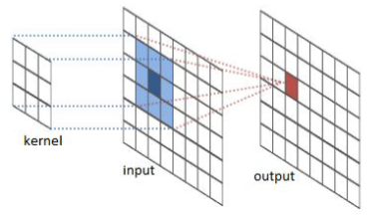
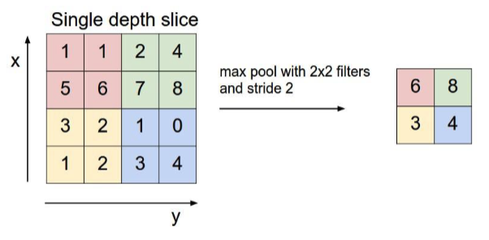
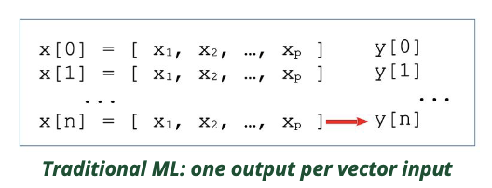
Model
Convolutional Neural Network
Neural network for image recognition/processing
Takes "parts" of an image and produces output for it
CNN Layers
Convolutional layer
Kernel moves across the image
Pooling layer
Kernel moves across image
Also, reduces number of parameters in input
Improves efficiency
Fully Connected layer
Dense layer
Receives output from previous layer
Matrix vector multiplication
Row vector of output = column vector
Notes:
Before we get into our model, let's have a brief review of what CNN is. CNN is a neural network for image recognition. It takes "parts" or kernels of an image and produces an output for those "parts"/kernels. There are three important layers that CNN consists of. Convolutional layers are where we create a kernel and move it across an image to make outputs for the image. Pooling layers are similar to convolutional layers but it also reduces the number of parameters in our input. This improves the efficiency of our model but also loses some information. Fully connected layers (which are dense layers in our case) take the output from our previous layers and does matrix vector multiplication on it. This makes our output rows become column vectors.

Slide 6
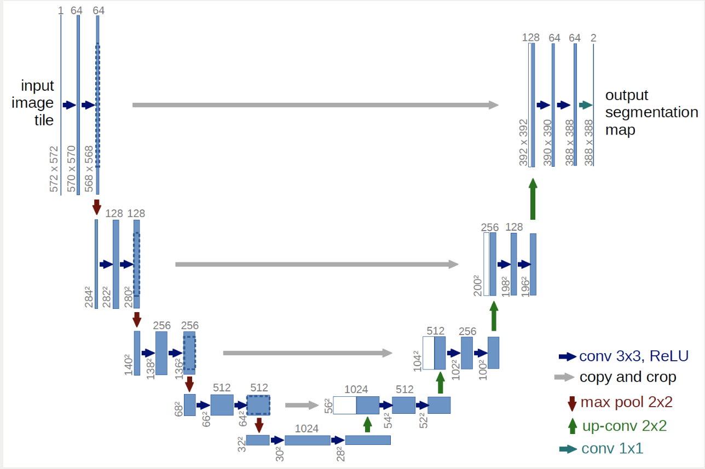
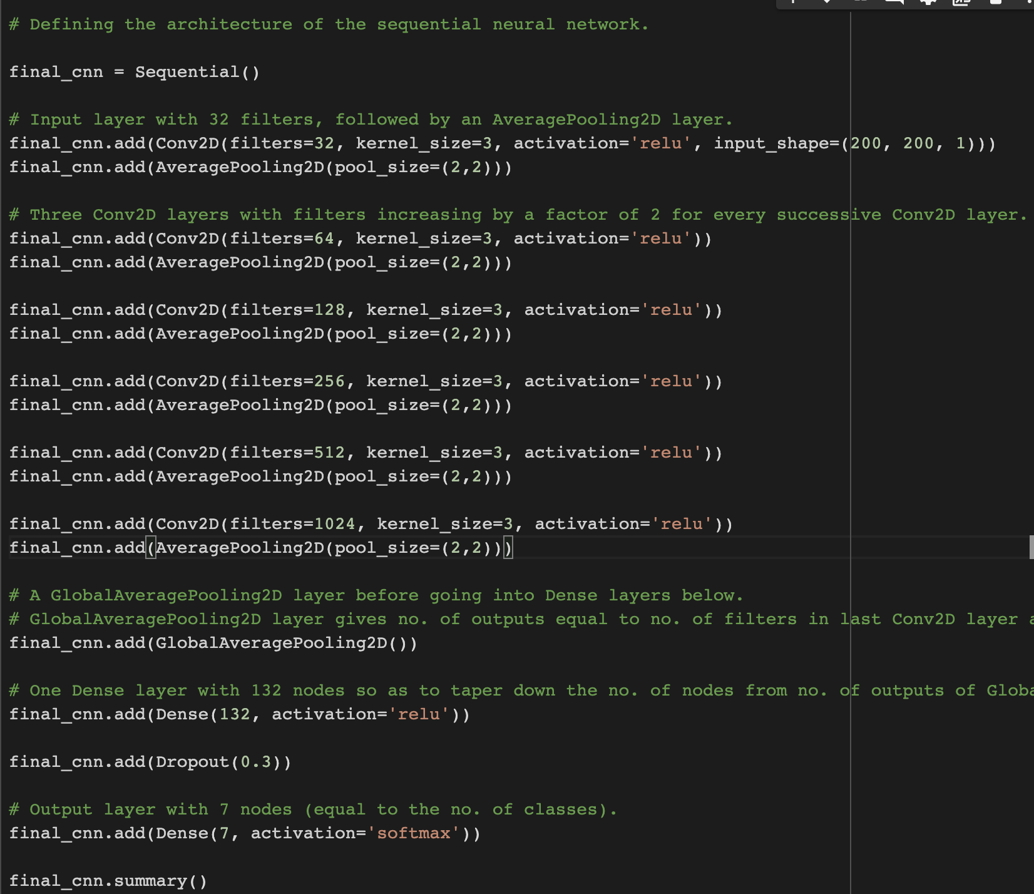
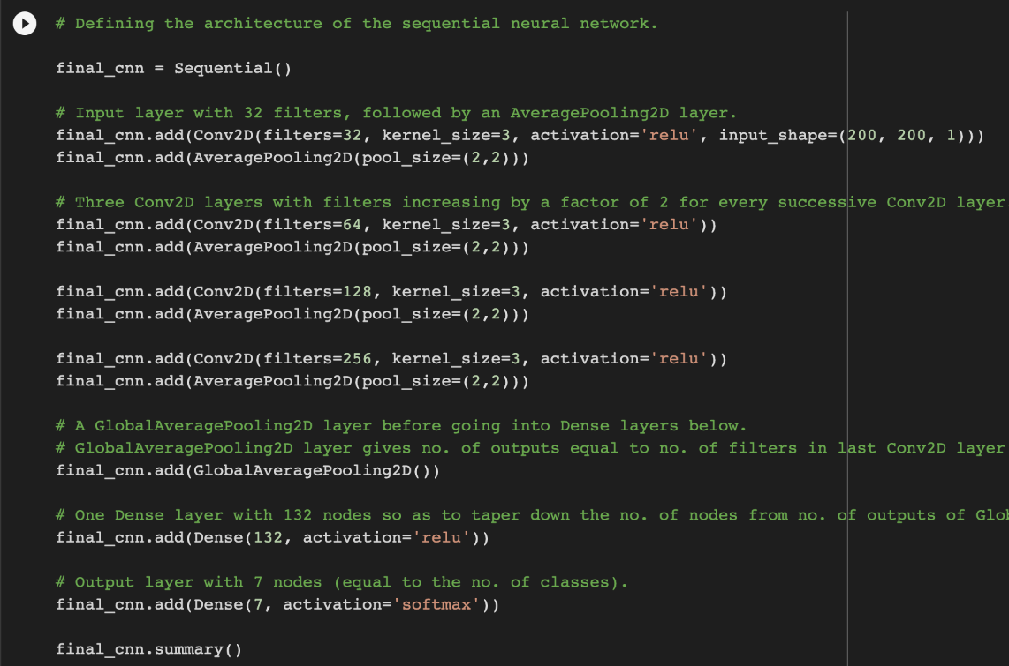
Model
Convolutional Neural Network
UNet Architecture
Referenced Architecture
Referenced Architecture + More Layers
Notes:
From the research that we found online, along with previous work we have done in the past, we decided that CNN would be the easiest and most efficient to use. We wanted to first try UNet which is an architecture mainly used for medical imaging because this is what was most familiar. Then we decided to reference some other resources to see if we can better them. The referenced architecture that we initially used was super basic. It had some convolutional and pooling layers along with some fully connected layers. However, after learning about RNN and CNN in class we wanted to see if we can better the model with more layers and including a Dropout() layer in case we were overfitting. We also played around with several different amounts of epochs and learning rates to get the best possible results given the time we had.

Slide 7
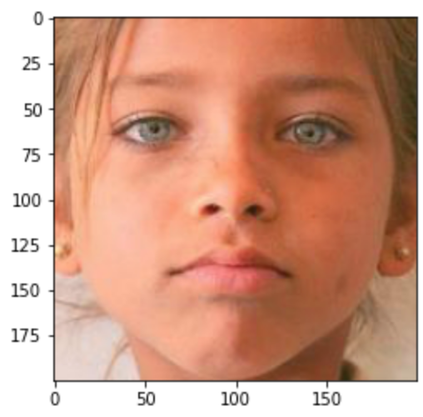
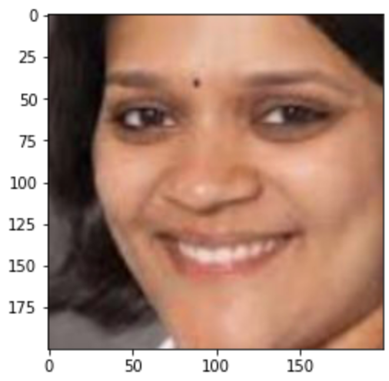
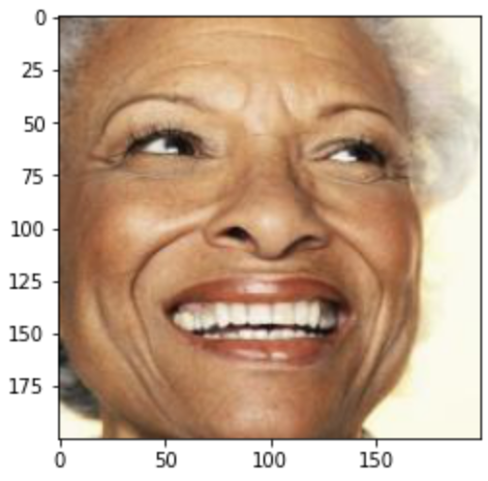
Our Predictions
Prediction: 3-9
Actual: 8
Prediction: 28-45
Actual: 37
Prediction: 46-65
Actual: 85

Slide 8
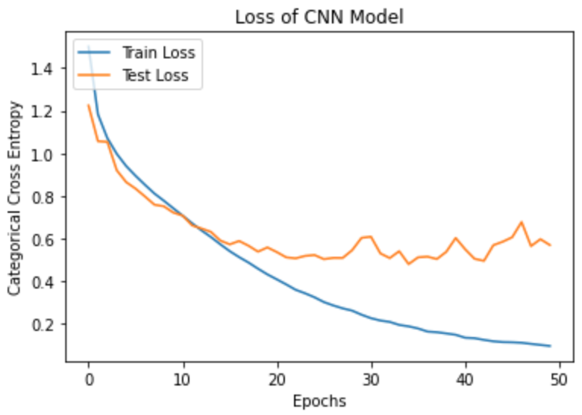
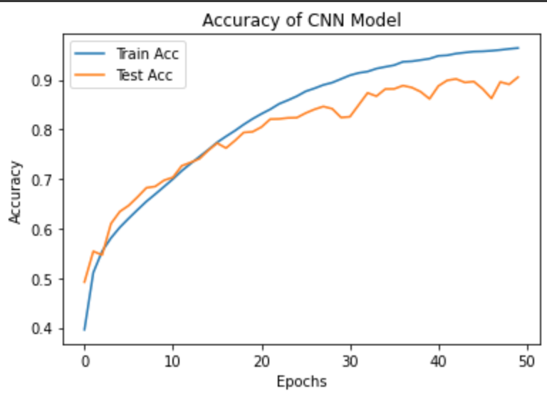
Performance
The overall accuracy of our model was over 90%
Notes:
So the overall accuracy of our model was over 90%. Adding additional layers and decreasing the learning rate of the model helped to increase the accuracy of the model. Having a larger training dataset also proved to be effective for training the model.
Loss Graph - The training loss goes down over time which indicates lower errors. The testing loss also decreases over time and does not increase rapidly which indicates that our model is not overfitting.
Accuracy Graph - The accuracy graph on the right clearly shows our model improving the accuracy after every epoch and it caps out after 50.

Slide 9
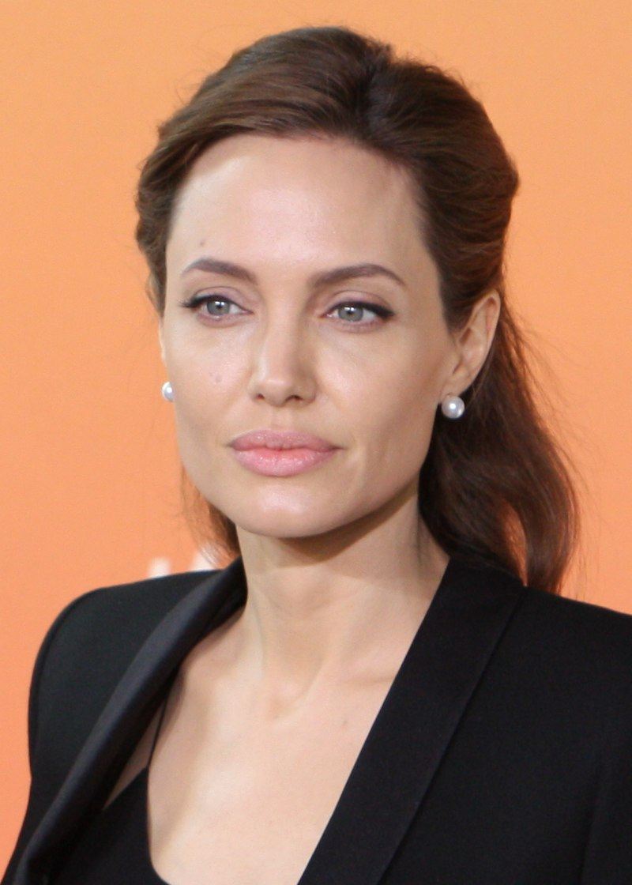
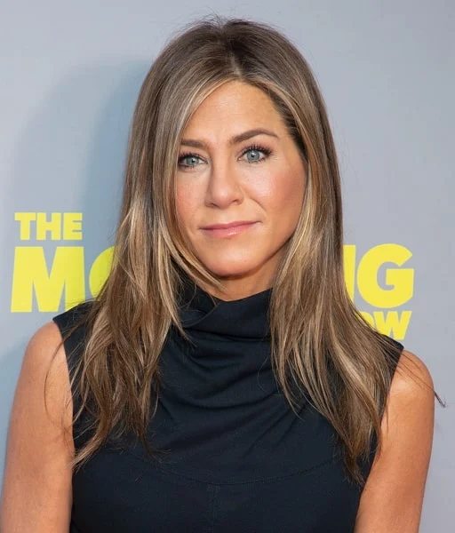

Conclusion
Predicting age is hard
How many people really look their age?
Could ML confidently predict a person's exact age one day?
In the future, we hope to use our original data and augment it ourselves to see if we could provide a CNN model.
47 Years Old
53 Years Old
Notes:
Using a computer to predict age is hard. Then again, how many people really look like their age especially in today's time? Look at Angelina Jolie. She looks like she's in her 30s but she's almost 50. Jennifer Aniston looks like she's in her 30s-40s but she's 53 years old. What about you? Have people said you look older or younger than your age? How do we expect a computer to predict these ages on the dot? Who knows maybe one day we will be able to exactly predict someone's age with machine learning. In future work, we would want to use our original data set and try to augment it ourselves to get more data to use for training.

Slide 10
Credits
https://www.geeksforgeeks.org/age-detection-using-deep-learning-in-opencv/
https://www.kaggle.com/code/rahuldshetty/age-and-gender-estimation-using-cnn
https://lmb.informatik.uni-freiburg.de/people/ronneber/u-net/
https://www.youtube.com/watch?v=G0iYWNRuDcM
https://medium.com/@skillcate/age-detection-model-using-cnn-a-complete-guide-7b10ad717c60
https://www.techtarget.com/searchenterpriseai/definition/convolutional-neural-network#:~:text=It%20is%20one%20of%20the,the%20processing%20of%20pixel%20data.
https://analyticsindiamag.com/a-complete-understanding-of-dense-layers-in-neural-networks/
RNNs.pdf (David Guy Brizan)
CNNs.pdf (David Guy Brizan)

